Slide 1
Advanced Web programming
Lec-3
C# Language
(Ref- Beginning of Asp.net 4.5 in C #- Pg no:28……)

Slide 2
Delegates
Delegates allow you to create a variable that “points” to a method. You can use this variable at any time to invoke the method. Delegates help you write flexible code that can be reused in many situations. They’re also the basis for events.
A delegate is a reference type variable that holds the reference to a method.
The first step when using a delegate is to define its signature.
The signature is a combination of several pieces of information about a method: its return type, the number of parameters it has, and the data type of each parameter.
A delegate variable can point only to a method that matches its specific signature.
Eg: If you have a method that accepts a single string parameter and another method that accepts multiple string parameters, you’ll need to use a separate delegate type for each method since one method has single string & other has multiple.

Slide 3
private string TranslateEnglishToFrench(string english)
{
// Code goes here.
}
This method accepts a single string argument and returns a string. With those two details in mind, you can define a delegate that matches this signature
private delegate string StringFunction(string inputString);
Once you’ve defined a type of delegate, you can create and assign a delegate variable at any time. Using the StringFunction delegate type, you could create a delegate variable like this ‘functionReference’:
StringFunction functionReference;
Using your delegate variable, you can point to any method that has the matching signature. In this example, the StringFunction delegate type requires one string parameter and returns a string.

Slide 4
Thus, you can use the functionReference variable to store a reference to the TranslateEnglishToFrench() method;
functionReference = TranslateEnglishToFrench;
[When you assign a method to a delegate variable in C#, you don’t use brackets after the method name. This indicates that you are referring to the method, not attempting to execute it. If you added the parentheses, the CLR would attempt to run your method and convert the return value to the delegate type, which wouldn’t work and give compile error]
Now that you have a delegate variable that references a method, you can invoke the method through the delegate.
string frenchString;
frenchString = functionReference("Hello");

Slide 5
The method that the functionReference delegate points to will be invoked with the parameter value "Hello", and the return value will be stored in the frenchString variable.
// Create a delegate variable.
StringFunction functionReference;
// Store a reference to a matching method in the delegate.
functionReference = TranslateEnglishToFrench;
// Run the method that functionReference points to.
// In this case, it will be TranslateEnglishToFrench().
string frenchString = functionReference("Hello");

Slide 6
In a more complex application, one method would create the delegate variable, and another method would use it. The benefit in this scenario is that the second method doesn’t need to know where the delegate points. Instead, it’s flexible enough to use any method that has the right signature.

Slide 7
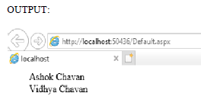
Delegate Problem
public partial class _Default : System.Web.UI.Page
{
public delegate string dele();
public static string display1()
{
string s1="Ashok Chavan";
return s1;
}
public static string display2()
{
string s2="Vidhya Chavan";
return s2;
}
protected void Page_Load(object sender, EventArgs e)
{
dele d1 = new dele(display1);
d1();
dele d2 = new dele(display2);
d2();
Label1.Text = d1();
Label2.Text = d2();
}
}

Slide 8
Object-Based Manipulation
The common data types have the built-in smarts to handle basic operations (such as counting the number of characters in a string). Even better, it means you can manipulate strings, dates, and numbers in the same way in C# and in VB.
To consider, every type in the .NET class library includes a ToString() method. The default implementation of this method returns the class name.
The following code snippet demonstrates how to use the ToString() method with an integer:
string myString;
int myInteger = 100;
// Convert a number to a string. myString will have the contents "100".
myString = myInteger.ToString();
All int variables are based on the Int32 type in the .NET class library.
The ToString() method is built into the Int32 class, so it’s available when you use an integer in
any language.

Slide 9
The String Type
The following code snippet shows several ways to manipulate a string by using its object nature:
string myString = " This is a test string ";
myString = myString.Trim(); // = "This is a test string"
myString = myString.Substring(0, 4); // = "This"
myString = myString.ToUpper(); // = "THIS"
myString = myString.Replace("IS", "AT"); // = "THAT"
int length = myString.Length; // = 4
The first few statements use built-in methods, such as Trim(), Substring(), ToUpper(), and Replace(). These methods generate new strings, and each of these statements replaces the current myString with the new string object.
The final statement uses a built-in Length property, which returns an integer that represents the number of characters in the string.

Slide 10
Example of Trim()
string MyString = " Big ";
Console.WriteLine("Hello{0}World!", MyString);
string TrimString = MyString.Trim();
Console.WriteLine("Hello{0}World!", TrimString);
// The example displays the following output:
// Hello Big World!
// HelloBigWorld!

Slide 11
A method is just a procedure that’s hardwired into an object. A property is similar to a variable—it’s a way to access a piece of data that’s associated with an object.
You can even use the string methods in succession in a single (rather ugly) line:
myString=myString.Trim().Substring(0,4).ToUpper().Replace("IS","AT");
you can use the string methods on string literals just as easily as string variables:
myString = "hello".ToUpper(); // Sets myString to "HELLO"

Slide 12
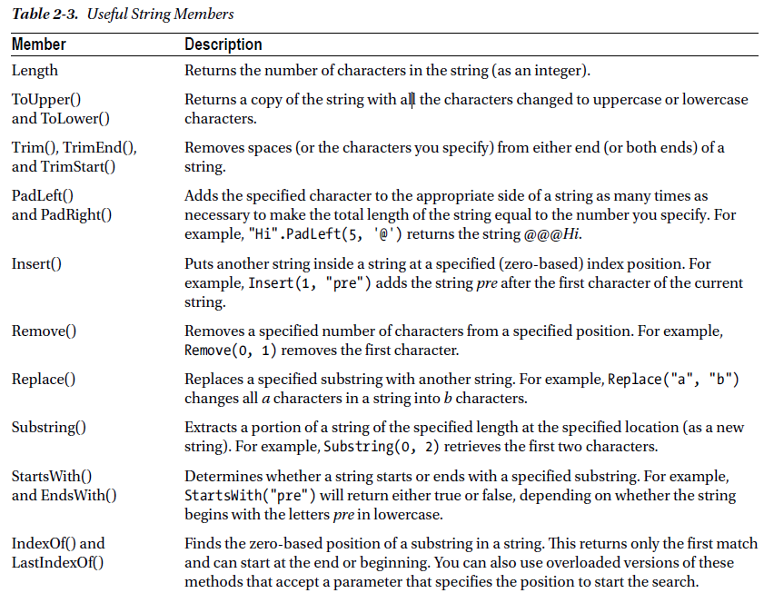
Table 2-3 lists some useful members of the System.String class.

Slide 13
The DateTime and TimeSpan Types
The DateTime and TimeSpan data types also have built-in methods and properties. These class members allow to perform three useful tasks:
1. Extract a part of a DateTime (for example, just the year) or convert a TimeSpan to a specific representation (such as the total number of days or total number of minutes)
2. Easily perform date calculations.
3. Determine the current date and time and other information (such as the day of the week or whether the date occurs in a leap year)
.NET provides the flexibility for manipulating date and time data by using members of Date Time.

Slide 14
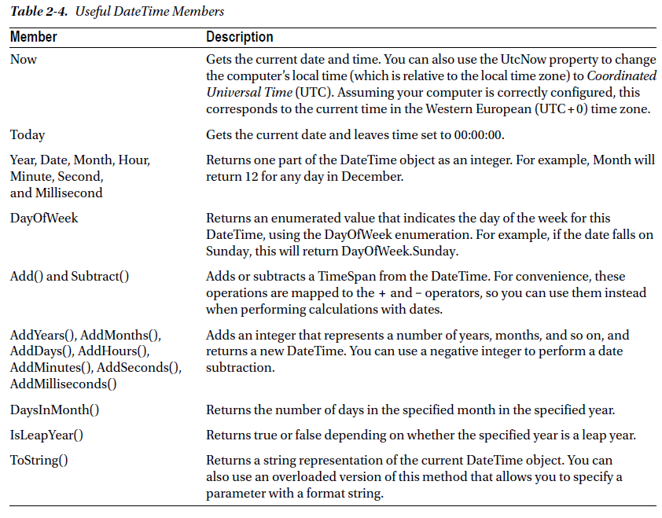

Slide 15
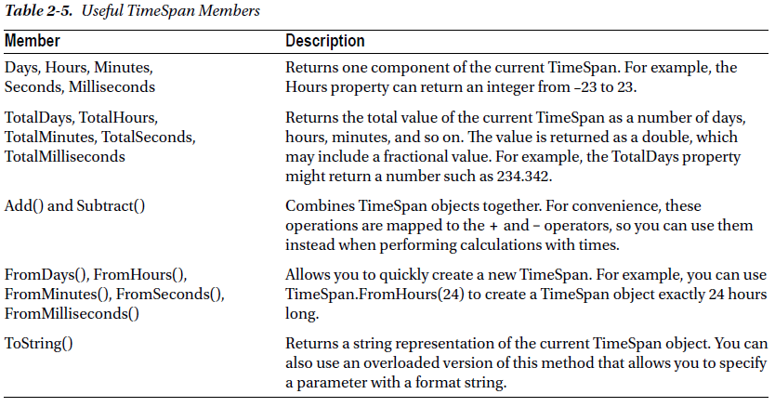
Notes:
https://www.dotnetperls.com/timespan

Slide 16
The Array Type
Arrays also behave like objects in the world of .NET. (Technically, every array is an instance of the System.Array type.)
To find out the size of a one-dimensional array, you can use the Length property or the GetLength() method, both of which return the total number of elements in an array:
int[] myArray = {1, 2, 3, 4, 5};
int numberOfElements;
numberOfElements = myArray.Length; // numberOfElements = 5
Also we can use the GetUpperBound() method to find the highest index number in an array.

Slide 17
The following code snippet shows GetUpperBound() in action:
int[] myArray = {1, 2, 3, 4, 5};
int bound;
// Zero represents the first dimension of an array.
bound = myArray.GetUpperBound(0); // bound = 4
On a one-dimensional array, GetUpperBound() always returns a number that’s one less than the length. That’s because the first index number is 0, and the last index number is always one less than the total number of items.
Arrays also provide a few other useful methods, which allow you to sort them, reverse them, and search them for a specified element. Table 2-6 lists some useful members of the System.Array class.

Slide 18
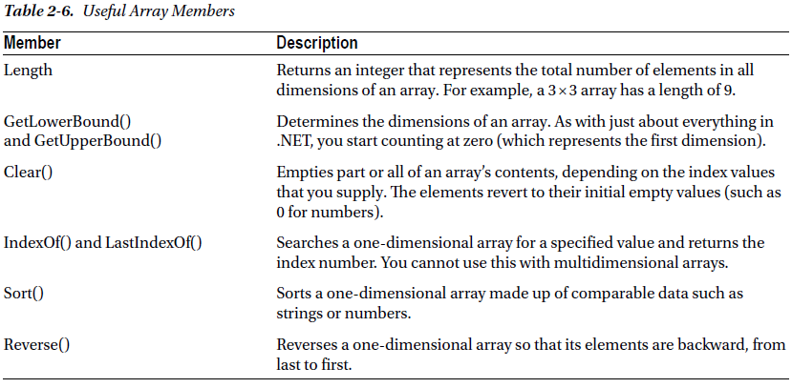

Slide 19
Chapter 3- Types, Objects, and Namespaces
.NET is all about objects.
The Basics About Classes:
Classes –classes are the code definitions for objects, which can be use to create as many objects as you need.
For example, you might have a class that represents an XML file, which can be used to read some data. If you want to access multiple XML files at once, you can create several instances of your class, as shown in Figure 3-1. These instances are called objects.

Slide 20
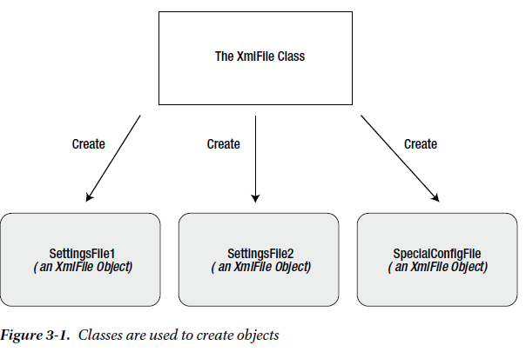

Slide 21
Classes interact with each other with the help of three key ingredients:
1 Properties: Properties allow you to access an object’s data. Some properties are read only, so they cannot be modified, while others can be changed.
2. Methods: Methods allow you to perform an action on an object. Unlike properties, methods are used for actions that perform a distinct task or may change the object’s state significantly.
For example, to open a connection to a database, you might call an Open() method in a Connection object.
3. Events: Events provide notification that something has happened. In modern Windows application, controls can fire events to trigger your code. For example, if a user clicks a button, the Button object fires a Click event, which your code can react to. The same pattern works with web controls in an ASP.NET web page.

Slide 22
In addition, classes contain their own code and internal set of private data.
Classes behave like “black boxes,” considering the public interface of a class, which is the set of properties, methods, and events that are available to use. Together, these elements are called class members.

Slide 23
Static Members
In .NET classes some class members can be used without creating an object first. These are called static members, and they’re accessed by class name.
For example, the DateTime type provides a static property named Now. You can access this property at any time by using the full member name DateTime.Now. You don’t need to create a DateTime object first.
The following code snippet uses static and instance members:
// Get the current date using a static property.
// Note that you need to use the class name DateTime.
DateTime myDate = DateTime.Now;
// Use an instance method to add a day.
// Note that you need to use the object name myDate.
myDate = myDate.AddDays(1);
// The following code makes no sense.
// It tries to use the instance method AddDays() with the class name DateTime!
myDate = DateTime.AddDays(1);

Slide 24
A Simple Class
To create a class, you must define it by using a special block structure:
public class MyClass
{
// Class code goes here.
}
You can define as many classes as you need in the same file.

Slide 25
To be continued….

